Slide 1

Stress detection in Students
by
Tharun K R
Roll No. 214G1A32B3
Purushotham B
Roll No. 214G1A3281
Sai Priya C
Roll No. 214G1A3291
Neha C
Roll No. 214G1A3268
Under the guidance of
Dr. P. Chitalingappa _{M. Tech., Ph.D.}
Assistant Professor
Department of Computer Science and Engineering (Data Science)
Srinivasa Ramanujan Institute of Technology
(Affiliated to JNTUA & Approved by AICTE) (Accredited by NAAC with ‘A’ Grade & Accredited by NBA (EEE, ECE & CSE)
Rotarypuram Village, B K Samudram Mandal, Ananthapuramu – 515701.
2024 - 2025

Slide 2
Abstract
This study leverages machine learning to detect stress in students using physiological and behavioral data such as heart rate variability, sleep patterns, physical activity, and academic workload. Data is collected through wearable sensors, self-reports, and digital activity logs, then processed by models like Support Vector Machines, Random Forests, and Neural Networks to classify stress levels into low, moderate, or high categories. The system helps monitor stress in real time using mobile apps or academic portals and offers personalized stress management tips. Preliminary results demonstrate high accuracy, suggesting its potential to enhance student mental health, academic performance, and overall well-being.
Keywords:Stress, Machine Learning Algorithms, Wearable Sensors

Slide 3

Contents
Abstract
Problem Statement
Objectives of Project
Literature survey
Proposed Work
Introduction
Existing System
Proposed System
Planning
Requirements
UML Diagrams
Data Flow Diagram
Data Processing Techniques
References
GitHub Link
Queries

Slide 4
Problem Statement
Stress is a critical factor that affects the personal and professional life of students. Detecting the emotional state of students experiencing stress is essential for ensuring their mental health and overall safety. To address this, our system leverages advanced image processing and machine learning techniques to identify stress levels in students accurately. By analyzing specific indicators, the system can provide early detection and intervention to support students in managing their stress effectively. However, these methods need to be tested in real-world situations to ensure they work well, are practical, and are reliable. This report focuses on understanding how these automated methods can detect stress effectively and how to make them more accurate and useful.
Keywords: Stress, Machine Learning algorithms, Support Vector Machine,Wearable Sensors.

Slide 5
Objectives of Project
Develop a Machine Learning model to predict stress levels based on collected data.
To define mood and state of the person.
To identify the impact of stress and other serious mental illnesses.
To provide solutions and remedies for the Students to recover his/her stress.
To Classify the level of stress into low, moderate or high using image dataset.

Slide 6
Literature survey
S.NO | JOURNAL | AUTHORS | TITLE | OUTCOME
1 | 9th International Conference for Convergence in Technology,(I2CT) 2024 | Ashutosh Singh, Khushdeep Singh, Amit Kumar | Machine Learning Algorithms for detecting Mental Stress in College Students | The study highlights the highest accuracy in stress classification reaching 95% using machime learning models
2 | Published by Elsevier Ltd | Ravinder Ahuja, Alisha Banga | Mental Stress detection in University Students using Machine Learning Algorithms | The paper concludes that the SVM algorithm outperforms other classification methods in assessing stress levels using the Perceived Stress Scale (PSS), with potential to improve mental health through more accurate methods.
3 | International Journal of Research Publication and Reviews | Ms. Ancy Paul, Ms. Resija | Stress Detection in College Students Using Machine Learning Algorithm | The paper presents a machine learning model that classifies college students' mental stress levels with 99% accuracy using Random Forest, and suggests applying the model to other groups while exploring real-time stress detection via images, videos, wearable sensors, and social media posts.

Slide 7
Cont..
S.NO | JOURNAL | AUTHOR | TITLE | OUTCOME
4 | IEEE Access, May 24, 2021. | SHRUTI GEDAM SANCHITA PAUL | A Review on Mental Stress Detection Using Wearable Sensors and Machine Learning Techniques | The paper shows that wearable sensors like HR and GSR are effective for stress detection using machine learning techniques like SVM and Random Forest. Future research should improve their accuracy, affordability, and practicality for real-time use.
5 | International Research Journal of Engineering and Technology (IRJET) | Rohini Hanchate, Harshal Narute, Siddharam Shavage, Karan Tiwari. | STRESS DETECTION USING MACHINE LEARNING | The paper presents a system designed to assess and quantify stress levels in individuals, providing results in percentage format to raise awareness about mental health. It aims to help individuals manage and reduce stress during long work sessions by offering real-time updates and alerts, promoting proactive well-being practices

Slide 8
Proposed Work
In this Project we will use Machine Learning to identify stress level in the students and to predict the stress earlier so that we can able to stop the major damage to their life before happening.
In the test, we will evaluate students amongst different situations. the level of stress was approved by the undertaking execution.
The proposed model includes PSS dataset collection , pre processing , feature extraction and applying machine learning algorithms.
Raw Data -> Pre-Processing of data -> Applying different classification algorithms -> Output.

Slide 9
Introduction
Stress is often associated with negative experiences or events. However, research shows that stress is a natural part of life.
Some common causes of stress Work-Related Stress, Academic Stress, Financial Stress, Personal Relationships, Health-Related Issues.
Every hour, a student commits suicide in the different part of the country. Our country has reported large suicide cases of the youngsters aging between the age group of fifteen to twenty nine, as per Lancet report(2012).
Number of suicide in our nation are increasing Consistently around 92 individuals commit suicide around the world, which makes it 800,000 for every year. Out of this 135000 (17%) are an inhabitant of India.
We will study how these factors affect people's minds using brainwave signals collected from the PSS dataset.

Slide 10
Existing System
PSS-Based Stress Classification: Some systems use PSS and similar scales, along with demographic and behavioral data, to predict an individual’s stress level. These systems typically employ machine learning algorithms such as Naive Bayes, Logistic Regression, and SVM to process responses and generate predictions.
Manual Techniques
Surveys :Widely used to assess stress levels through self-reported responses.
Examples: Perceived Stress Scale (PSS)

Slide 11
Proposed System
Stress Detection Using Wearable Devices:
Some systems integrate wearable devices such as smartwatches and fitness trackers to capture real-time physiological data (e.g., heart rate, skin conductance) and use algorithms to detect stress in real-time. For example, a system might use a combination of random forests and SVM to classify stress levels based on sensor data.
Stress Detection Using Live Camera:
Stress detection using a live camera is a powerful tool that can be applied across various domains, including healthcare, workplace environments, education, and personal well-being. By leveraging facial expression recognition, body posture analysis, and real-time processing, a system that detects stress using a live camera can offer numerous benefits and applications.

Slide 12
Planning
Sensor Data
Heart Rate: Measure Heart Rate Variability (HRV) to detect stress-induced changes.
Electrodermal Activity (EDA): Tracks skin conductance changes due to stress.
Temperature Sensors: Analyze body temperature fluctuations related to stress.
Using these image datasets in a stress detection system helps identify stress in real-time through facial expressions, posture, and other signs, allowing for quick action.
Facial Expression Recognition:
FER2013 is a popular dataset used for facial expression recognition tasks. It consists of 35,887 labeled images categorized into 7 emotion classes: angry, disgust, fear, happy, sad, surprise, and neutral.

Slide 13
Requirements
Hardware:
Wearable devices (e.g., smartwatches, fitness trackers) for physiological data collection.
Cameras for facial expression analysis.
Computer with at least: 8 GB RAM, 256 GB storage
Software:
Operating Systems: Wndows 8
Programming Languages (e.g., Python, Java)
Frontend: Html,CSS,JS
Backend:Database
Data:
User Image Dataset: As our system need user image dataset that will used to extract the facial expression to detect person is stressed or not. When user enter into system the system camera will capture the image of user and store it in the image dataset.

Slide 14
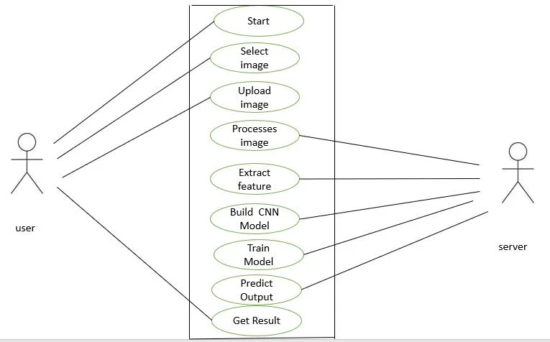
UML Diagrams

Slide 15
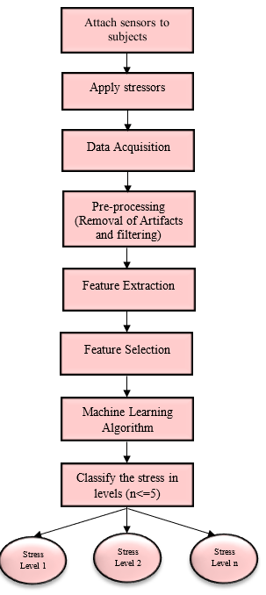
Data Flow Diagram

Slide 16
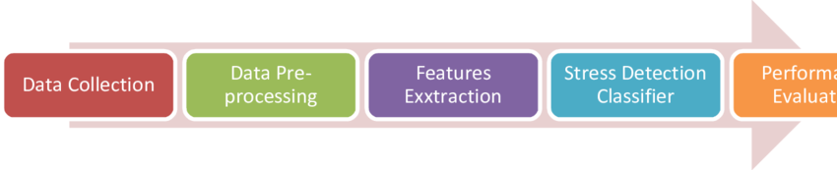
Data Processing Techniques
Data Collection: Gather data from various sources like sensors, surveys, or images to represent the problem (e.g., physiological signals, facial expressions, or text responses).
Data Preprocessing: Clean and prepare the collected data by handling missing values, scaling features, and removing irrelevant or noisy information.
Feature Extraction: Identify and extract key attributes (e.g., heart rate, voice tone, or text sentiment) that are most relevant for stress detection
Stress Detection Classifier: Use machine learning algorithms (e.g., SVM, Decision Trees, or Neural Networks) to classify whether a person is stressed or not based on the extracted features.
Performance Evaluation: Assess the classifier's accuracy, precision, recall, and F1 score using metrics like confusion matrix

Slide 17
Reference
[1].Ravinder Ahuja and Alisha Banga, “Mental Stress detection in students”,Elsevier Ltd , vol. 11, pp. 349-353, Jan. 2019.
[2].Arsalan, Aamir, Syed Muhammad Anwar, and Muhammad Majid “Mental stress detection using data from wearable and non-wearable sensors: a review.”
[3] S. A. Singh, P. K. Gupta, M. Rajeshwari, and T. Janumala, ‘‘Detection of stress using biosensors,’’ Mater. Today, vol. 5, no. 10, pp. 21003–21010, 2018.
[4] J. Ogorevc, A. Podlesek, G. Geršak, and J. Drnovšek, ‘‘The effect of mental stress on psychophysiological parameters,’’ in Proc. IEEE Int. Symp. Med. Meas. Appl., Bari, Italy, May 2011, pp. 294–299

Slide 18
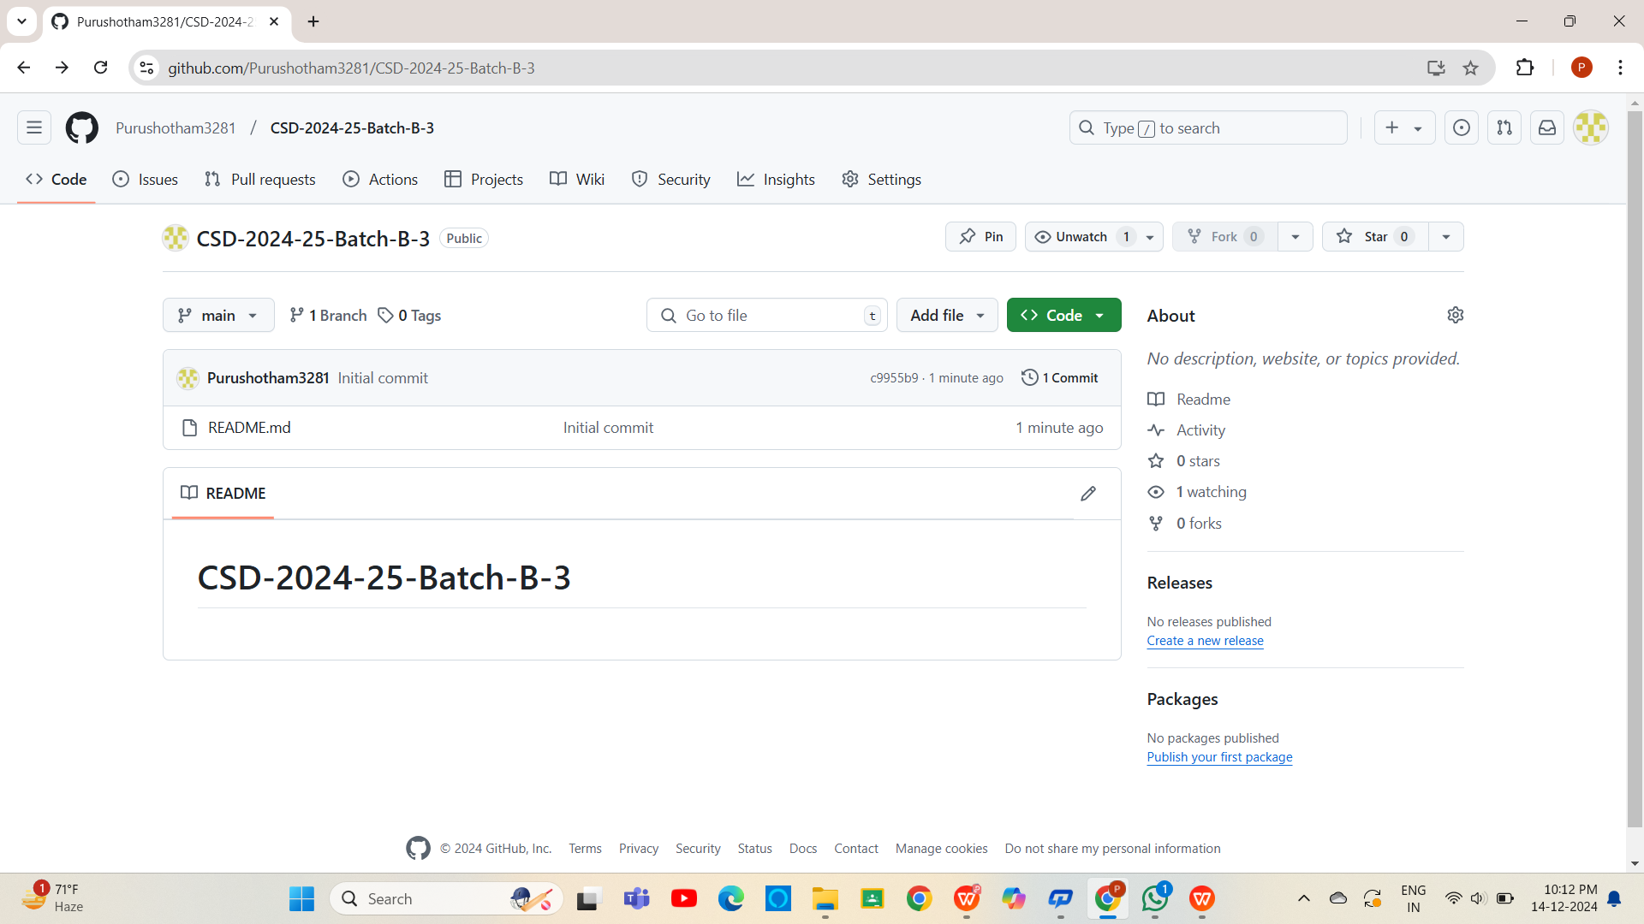

Git Hub Dashboards of each student

Slide 19
Any Queries?

Slide 20
Thank You!!!

